Slide 1
COMP 122/L Lecture 9
Mahdi Ebrahimi Slides adapted from Dr. Kyle Dewey

Slide 2
Outline
The compare (cmp) instruction
Conditionally-executed instructions
Translating simple if statements

Slide 3
The compare (cmp) instruction

Slide 4
Compare (cmp)
Subtracts two given operands, discarding the result.
However, the status bits (e.g., carry, zero, etc.) get set.
Syntax
CMP Rn, Operand2
where:
Rn is the ARM register holding the first operand.
Operand2 is a flexible second operand.
Operation
These instructions compare the value in a register with Operand2. They update the condition flags on the result, but do not place the result in any register.
The CMP instruction subtracts the value of Operand2 from the value in Rn. This is the same as a SUBS instruction, except that the result is discarded.
Notes:
Syntax
CMP{cond} Rn, Operand2
where:
cond is an optional condition code.
Rn is the ARM register holding the first operand.
Operand2 is a flexible second operand.
Operation
These instructions compare the value in a register with Operand2. They update the condition flags on the result, but do not place the result in any register.
The CMP instruction subtracts the value of Operand2 from the value in Rn. This is the same as a SUBS instruction, except that the result is discarded.

Slide 5
Compare (cmp)
Subtracts two given operands, discarding the result.
However, the status bits (e.g., carry, zero, etc.) get set.
mov | r0, | #5
cmp | r0, | #5

Slide 6
Compare (cmp)
Subtracts two given operands, discarding the result.
However, the status bits (e.g., carry, zero, etc.) get set.
mov r0, #5
cmp r0, #5
Sets zero bit/flag (result is zero)

Slide 7
Compare (cmp)
Subtracts two given operands, discarding the result.
However, the status bits (e.g., carry, zero, etc.) get set.
mov | r0, | #5
cmp | r0, | #5
Sets zero bit/flag (result is zero)
mov | r0, | #5
cmp | r0, | #20

Slide 8
Compare (cmp)
Subtracts two given operands, discarding the result.
However, the status bits (e.g., carry, zero, etc.) get set.
mov r0, #5
cmp r0, #5
Sets zero bit/flag (result is zero)
mov r0, #5
cmp r0, #20
Sets negative bit/flag (result is negative)

Slide 9
Significance
Status bits say something about the result of arithmetic comparisons

Slide 10
Significance
Status bits say something about the result of arithmetic comparisons
mov r0, #5
cmp r0, #5
Sets zero bit/flag (result is zero)

Slide 11
Significance
Status bits say something about the result of arithmetic comparisons
mov r0, #5
cmp r0, #5
Sets zero bit/flag (result is zero)
Operands must have been equal.

Slide 12
Significance
Status bits say something about the result of arithmetic comparisons
mov r0, #5
cmp r0, #5
Sets zero bit/flag (result is zero)
Operands must have been equal.
mov r0, #5
cmp r0, #20
Sets negative bit/flag (result is negative)

Slide 13
Significance
Status bits say something about the result of arithmetic comparisons
mov r0, #5
cmp r0, #5
Sets zero bit/flag (result is zero)
Operands must have been equal.
mov r0, #5
cmp r0, #20
Sets negative bit/flag (result is negative)
First operand must be < second.

Slide 14
Conditionally-executed instructions

Slide 15
Conditionally-Executed Instructions
ARM allows for instructions to be conditionally executed, depending on the values of the status bits.

Slide 16
Conditionally-Executed Instructions
ARM allows for instructions to be conditionally executed, depending on the values of the status bits.
movmi r0, #42

Slide 17
Conditionally-Executed Instructions
ARM allows for instructions to be conditionally executed, depending on the values of the status bits.
movmi r0, #42
move if the negative bit is set

Slide 18
Conditionally-Executed Instructions
ARM allows for instructions to be conditionally executed, depending on the values of the status bits.
movmi r0, #42
move if the negative bit is set
movpl r1, #23

Slide 19
Conditionally-Executed Instructions
ARM allows for instructions to be conditionally executed, depending on the values of the status bits.
movmi r0, #42
move if the negative bit is set
movpl r1, #23
move if the negative bit is not set

Slide 20
Conditionally-Executed Instructions
ARM allows for instructions to be conditionally executed, depending on the values of the status bits.
moveq r0, #42

Slide 21
Conditionally-Executed Instructions
ARM allows for instructions to be conditionally executed, depending on the values of the status bits.
moveq r0, #42
move if the zero bit is set

Slide 22
Conditionally-Executed Instructions
ARM allows for instructions to be conditionally executed, depending on the values of the status bits.
moveq r0, #42
move if the zero bit is set
movne r0, #42

Slide 23
Conditionally-Executed Instructions
ARM allows for instructions to be conditionally executed, depending on the values of the status bits.
moveq r0, #42
move if the zero bit is set
movne r0, #42
move if the zero bit is not set

Slide 24
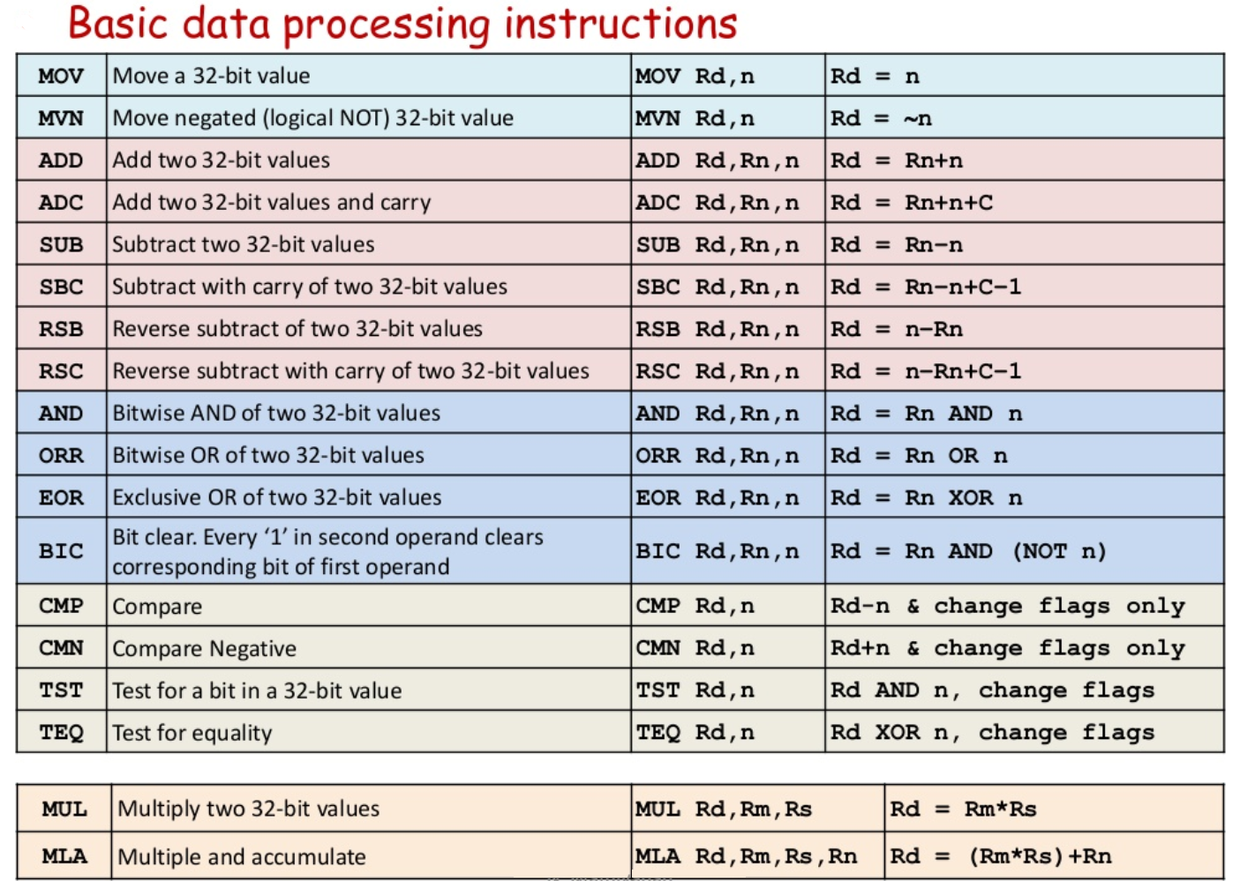

Slide 25
Example:
conditional_execution.s

Slide 26
Translating simple if
statements

Slide 27
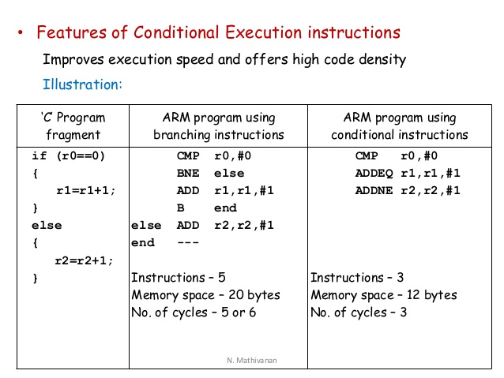

Slide 28
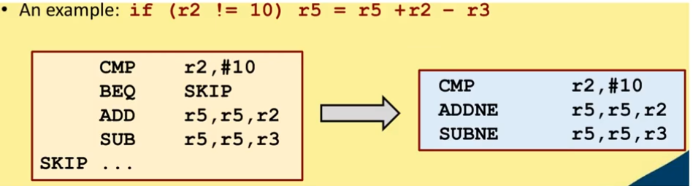
Example 1

Slide 29
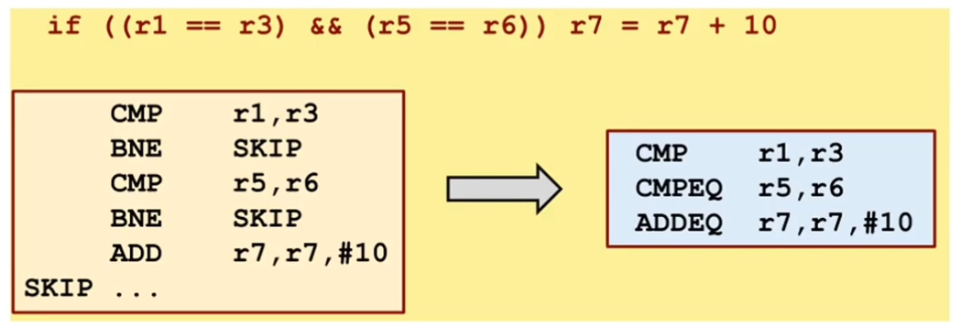
Example 2

Slide 30
Translating if
Simple ifs can be translated with conditionally-executed instructions
Example:
AbsoluteValue.java
absolute_value.s

